Slide 1
Concepcion Holy Cross College
Campus Information System
Edsar A. Bondoc
Instructor
Proponent:
SAGUM, Randy H.

Slide 2
Introduction
Objective Of The Study
Scope And Delimitation
Related Studies
Research Methodologies
The Proposed System
Presentation, Analysis And Interpretation Of Data

Slide 3
Chapter 1 introduction
Computer Software's
Background

Slide 4
Objective of the study
Statement of the Objectives
General. This study aimed to develop a Campus Information System that will include registration, enrollment, and grading system for Concepcion Holy Cross College. This information system is intended to provide a fast and systemized way of handling enrollment procedures.
Specific. In order to meet the general objective of the study, the proponents seek to achieve the following specific objectives.
To study and explain the current enrollment system practiced by the Concepcion Holy Cross College, Inc.
To identify the problems they meet by using the existing system.
To design and develop the proposed system.
To evaluate the existing and developed system in terms of:
Security
Efficiency
Reliability
Hypothesis of the Study
Null Hypothesis (Ho). There is no significant difference between the existing and the proposed system in terms of security, efficiency and reliability.
Alternative Hypothesis (Ha). There is a significant difference between the existing and the proposed system in terms of security, and reliability.

Slide 5
Scope and limitation
The following are the scope of the System
Enrollment
Registration
Grading
Evaluation
Assessments
Requirements.

Slide 6
The following are the limitations of the System
Payment.
Requirements checking
Student balance

Slide 7
Significance of the study
Students
Faculty
Parents
Public

Slide 8
Chapter 2 Review of Related Literatures and studies
Local Literature
In an article entitled Price and food security update Philippines Issue 16 by wfp.org (wfp.org, 2013) stated.: “The PhilSIS is envisioned to be a web-based information system that would strengthen food security planning, implementation and evaluation through improved organization, analysis and dissemination of relevant data and information in the Philippines.

Slide 9
Foreign Literature
In the booklet entitled Building an Automated Student Record System (NCES. 2000) stated: “When student records are added to overall management information system that includes information on staff, materials, and budgeting for the school or school district, more management activities can be accomplished and efficiency will be improved.”

Slide 10
Local Study
According to Erwin A. Alampay in their study entitled Monitoring Employee use of the internet in Philippine Organizations (Alampay, 2010): “The connection to local/wide area network could extend the sharing of files, documents and other information beyond the domains of the company”.

Slide 11
Foreign Study
According to Chandrinos and Trahanias in their research study entitled Beyond HTML: Web-Based Information Systems (Chandrinos & Trahanias, 2000) : “A Web-based architecture should serve as the connecting glue between subsystems developed or even executing on different platforms. It presents excellent modularity and openness per component. It also allows for extremely fast prototyping.

Slide 12
Chapter3 Research Methodologies
Research Design
System Development methodology
Spiral model
Identification
Design
Construct or Build
Customer Feedback

Slide 13
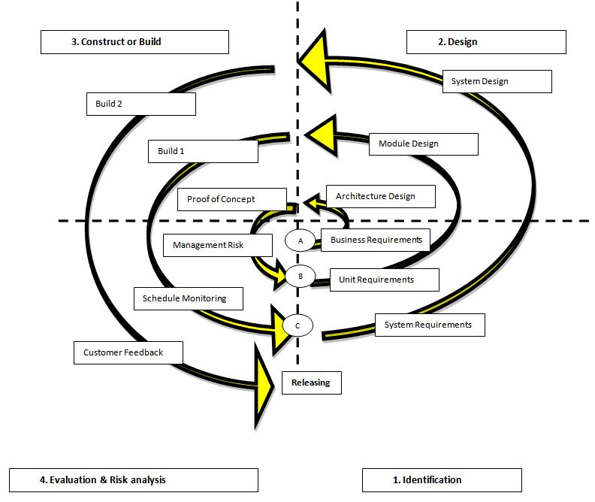
The spiral model has four phases. A software project repeatedly passes through these phases in iterations called Spirals.

Slide 14
Research Locale
1. Subject of the Study
2. Population
Data Gathering Tools
1. Interview
2. Observation
3. Questionnaire or Evaluation Forms
4. Library and Internet Research
Data Gathering Procedure
Survey

Slide 15
Statistical Treatment
Weighted mean
Likert scale
T-test
Rubrics method

Slide 16


The formula for the weighted mean and average weighted mean:
`
where:
n = refers to the total number of respondents
f = refers to the number of times that a given number was chosen by a respondent as a rating for a given criterion
X = represents any one numerical rating for a given criterion

Slide 17

Formula for Variance ( )
= Weighted Mean
= total sample size
= Variance

Slide 18

Formula for t-test
Where:
= t-test computed value
= Weighted mean of the Existing System
= Weighted mean of the Proposed System
= Variance of the Existing System
= Variance of the Proposed System
= Sample Size

Slide 19
Table 3.0 Interpretation Table
 | Likert Scale | Verbal Interpretation
1 | 0.000 – 1.499 | Poor
2 | 1.500 – 2.499 | Fair
3 | 2.500 – 3.499 | Satisfactory
4 | 3.500 – 4.499 | Very Satisfactory
5 | 4.500 – 5.000 | Excellent
Likert Scale

Slide 20
Rubric Method
Criteria |  |  | Existing System | Proposed System
1. | Security
 | (5) Description of the developed system in terms of Security
2. | Efficiency
 | (5) Description of the developed system in terms of Efficiency
3. | Reliability
 | (5) Description of the developed system in terms of Reliability

Slide 21
Chapter 4
PRESENTATION, ANALYSIS AND INTERPRETATION OF DATA
This chapter presents the actual data, statistical analysis and interpretation gathered by the researchers based on the data collected from the evaluator’s feedback. The respondents were composed of two hundred (220) students and two (2) admin staff of Concepcion Holy Cross College, Inc. College Department. Data gathered from survey questionnaires were organized in table to reflect the reaction from the respondents.
The Existing Enrollment system of Concepcion Holy Cross College, Inc.
The proponents tabulated the responses from the distributed questionnaires for gathering substantial information that served as basis of developing the proposed system. In this section, graphical representations and descriptive statistics are provided to support the data gathered. The respondents, a total of 222, were the college students and admin staff of Concepcion Holy Cross College, Inc.
Table 4.1 Classification of the Respondents
 | Frequency | Percentage
Students | 220 | 99.09%
Admin Staff | 2 | 0.91%
Total | 222 | 100%

Slide 22
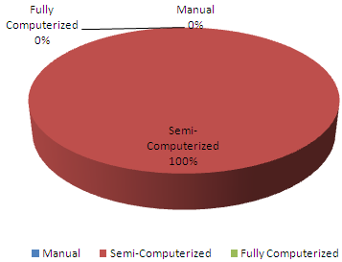
1.1 Concepcion Holy Cross College, Inc. Current Mode of Enrollment System.
Respondents were asked to mark the currently used enrollment system of the school.
Figure 4.1 Current Mode of the Concepcion Holy Cross College, Inc. Enrollment System
Table 4.2 Current Mode of the Concepcion Holy Cross College, Inc. Enrollment System
 | Frequency | Percentage
Manual | 0 | 0 %
Semi-Computerized | 222 | 100 %
Fully Computerized | 0 | 0 %

Slide 23
Figure 4.1 and Table 4.2 shows that 222 of the respondents of them marked that the enrollment system used in the school is semi-computerized. Therefore, the Concepcion Holy Cross College, Inc. uses a semi-computerized mode of enrollment system. The system is composed of a registration form and Microsoft Excel spreadsheet.
1.3 Context Diagram of the Existing System. The context diagram of the existing system in Figure 4.2 is presented in analytical tool to identify the scope and boundary for the system and the project to be developed.
Shown in the diagram is the process undergone by the student, the admin staff with the existing system. All students needed to fill out a plenty of forms for registration and they need to copy schedule from the given copy. On the other hand admin staff needed to compute and get all records of student to evaluate student to enroll. Also instructor need time to get their load after enrollment .
Students
Admin staff
Fill out registration form & subjects & schedules
Get student no
Manualy compute assessment & evaluation
Manualy record grades of student
Existing system
Submit computed raw scores of grad
Instructor
Get copy of load
Figure 4.2 Context Diagram of the Existing System

Slide 24
The Problems Encountered by the Student using the Existing System. The respondents were asked to select the problems they encounter using their current enrollment system using a registration form.
Table 4.3 Problems Encountered using the Existing Grading System.
 | Frequency | Percentage
Filling out plenty of data | 150 | 67.56 %
Slow process of enrollment | 20 | 9.00 %
Hard to get result of grades | 45 | 18.08%
Others | 7 | 3.15 %
Figure 4.3 Problems Encountered using the Existing Enrollment System.

Slide 25
2.1 Problems Encountered using the Existing Enrollment System.
Figure 4.3 and Table 4.3 shows the problems encountered by the students using the existing system. More than sixty seven percent (67.56%) of them answered that they felt tired after enrollment because of plenty form to fill out. Nine percent (9%) complaining of the slow process of enrollment that could make them more tired while waiting for their assessment while eighteen percent (18%) of them have irritated when they still not get their result in grade after school semester.
2.2 Features or Functions to be Included in the Proposed System. The respondents were also asked to select from the given features or functions that they would like to add in the proposed system. Otherwise, the respondents should specify the features of functions if necessary.
Table 4.4 Features or Functions to be Included in the Proposed System.
 | Frequency | Percentage
Others | 0 | 0 %
Online payment and billing system | 200 | 91%
Scheduling system | 20 | 9%

Slide 26
Figure 4.3 Problems Encountered using the Existing Enrollment System.
2.1 Problems Encountered using the Existing Enrollment System.
Figure 4.3 and Table 4.3 shows the problems encountered by the students using the existing system. More than sixty seven percent (67.56%) of them answered that they felt tired after enrollment because of plenty form to fill out. Nine percent (9%) complaining of the slow process of enrollment that could make them more tired while waiting for their assessment while eighteen percent (18%) of them have irritated when they still not get their result in grade after school semester.

Slide 27
2.2 Features or Functions to be Included in the Proposed System. The respondents were also asked to select from the given features or functions that they would like to add in the proposed system. Otherwise, the respondents should specify the features of functions if necessary.
Table 4.4 Features or Functions to be Included in the Proposed System.
 | Frequency | Percentage
Others | 0 | 0 %
Online payment and billing system | 200 | 91%
Scheduling system | 20 | 9%
Figure 4.4 Features or Functions to be Included in the Proposed System.
Table 4.4 and Figure 4.4 show the features or functions that the respondents would like to be included in the proposed system. Most of them wanted to include them like to include billing in the proposed system to make their balance accessible while others want to include scheduling system that could settle automatically all the schedules per classes.

Slide 28
3. Design and Development of the Proposed System
Requirements Gathering and Refinement
From these, the proponents identified the users for the system and what are the necessary elements and components concerned with the system such as enrollment reports. The researchers also identified the roles of such users and the limits of their privileges by the degree of their positions within the system.
Quick Design
Based from the context diagram of the existing system the proponents were able to come up with another context diagram for the developed system (See Figure 4.5) that guided the group for building the prototype of the system.
As shown in the figure 4.6 students does not need to record their schedules during enrollment because the proposed system will provide schedules for them in their account online. Also the staff does not need to compute the cost of enrollment manually and evaluate student. The proposed system already evaluates students during enrollment. The system has an access account per student to access their grades online. Instructors could also input the grades of their pupils online.

Slide 29
Fill out registration form
Students
Admin staff
Get evaluation and computed assesment
Accessing of grades
Access of grades
Proposed System
Get student no and password
Submit computed raw scores of grade online
Instructor
Check load from an account
Figure 4.5 Context Diagram of the Proposed System

Slide 30
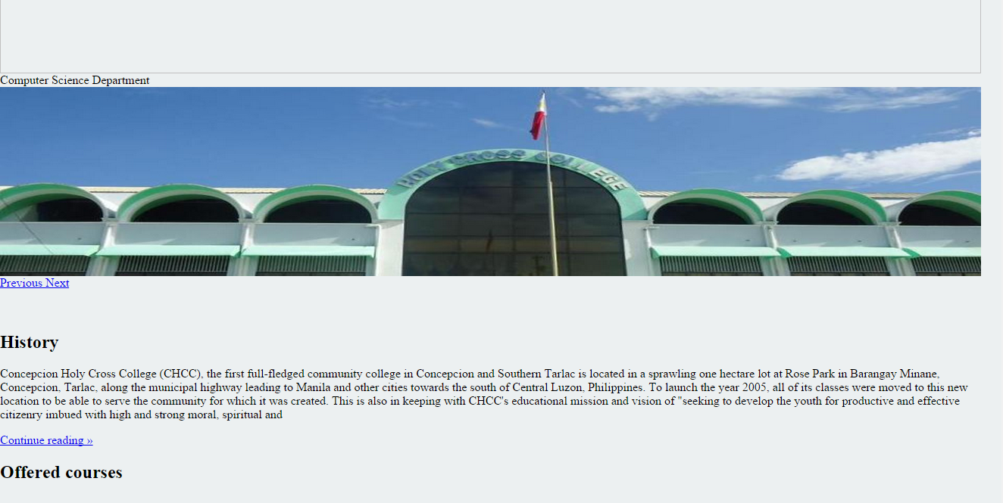
Building Prototype
Figure 4.6 Initial Prototype of the Proposed System (Main Window)
Shown in Figure 4.6 is the initial prototype built by the proponent that will be evaluated by the client. It shows the visual presentation of the software side of the system to be developed and its components.

Slide 31
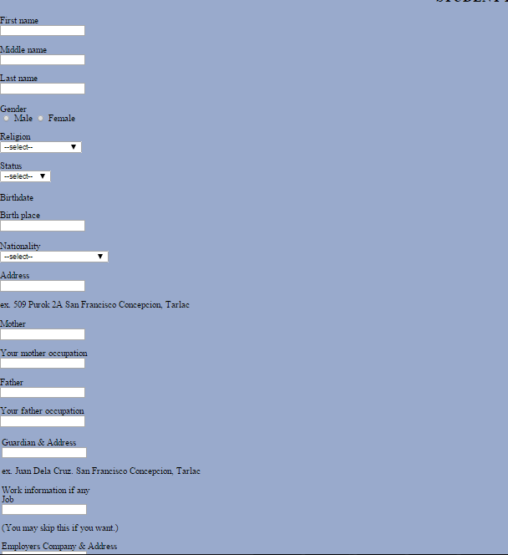
Figure 4.7 Initial Prototype of the Proposed System (Registration Window)
The registration window, as seen in Figure 4.8 the student could register through online an get registration number to enroll.

Slide 32
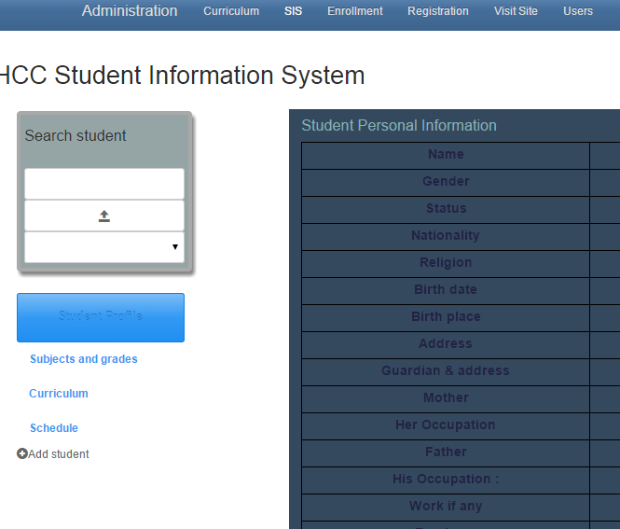
Figure 4.8 Initial Prototype of the Proposed System (Students Window)
The students’ window (see Figure 4.8) enables the administrator manage records of students such as viewing grades of every students check their schedule and could add and edit data.

Slide 33
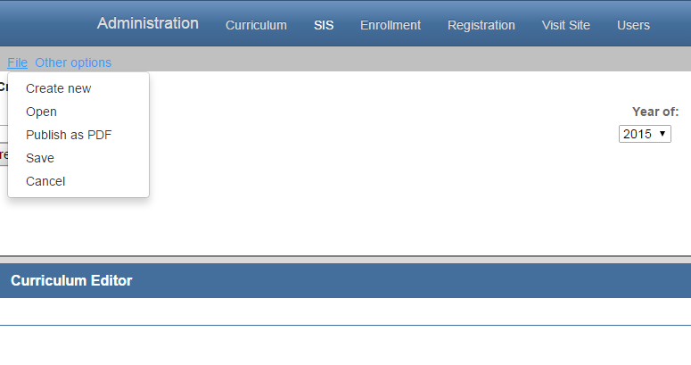
Figure 4.9 Initial Prototype of the Proposed System (admin window)
In figure (4.9) which in the admin window an admin staff could make curriculum, courses and subjects to use in enrollment process.

Slide 34
Client Evaluation of Prototype
After a continuous evaluation, the proponent gathered a collection of suggestions and specifications throughout the iterations of evaluation from the client:
Log in panel should show first before the accessing the admin window
It should have access of every students record and editing their data.
It should have a filter pane for searching specific subjects and students instructors, and enrollment transactions.
Refining Prototype
Based on the students’ evaluation, the developers now then refined the software according to the specifications of the client and provide another quick design for another prototype to be built and evaluated. This allowed for particular operations to be tested and refined without the enormous effort that would be required if a design were to be implemented.
Figure 4.10 shows the Log Window prototype as specified by the client. The user will initially view this screen that allows user to log in and input username and password. With this, unauthorized users will not be able to view the student window.

Slide 35

Figure 4.11 Refined Prototype of the Study (Main Window)
Engineered Product
After a finite number of iterations, the final system was ready for implementation. In this methodology, the system was evolved as a result of periodic shuttling of information between the client and developer. The system was ready for evaluation by the users – students and admin staff. After the finalizing the system, the developers laid out an implementation pla that provides a systematic process for system use. Installation, training of users, and system evaluation were undergone for the system to be ready for use.

Slide 36
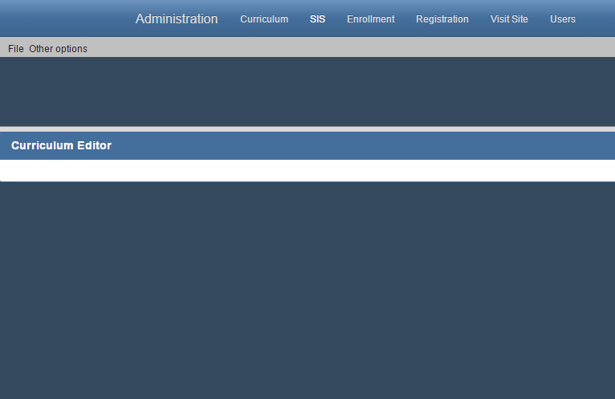
Figure 4.13 Admin window
Based from the necessary requirements in hardware and software for the system, the proponents have evaluated the client’s existing computer resources. Upon visiting and checking the computer resources of the client, the proponent found out that all of the client’s computer resources are able to meet at least if not the recommended requirements needed for the system.

Slide 37
Hardware Specification. Table 4.5 specifies the basic hardware requirements needed to run the proposed system. One could refer to this table to know what requirements had transpired during the development of the proposed system. The hardware specification is required since it is connected to the system requirements of the proposed system.
Table 4.5 Hardware Specification
Software Specification. Table 4.6 specifies the software needed in implementing the proposed system.
Components | Minimum | Recommended | Used
Processor | Intel core IE 3 | Intel core IE 3 or Higher | Intel core IE 3
RAM Memory | 2Gb | 2 Gb or Higher | 2 Gb
Hard Disk Space | 100 Gb | 60 Gb or Higher | 250 Gb
Video Card | 64 Mb | 1 Gb or Higher | 64 Mb
LAN Card | 10Mbps | 100Mbps | 100Mpbs
Wireless LAN Card | 54Mbps | 54Mbps | 54Mbps
Mouse | PS/2 Compatible | USB Compatible | PS/2 Compatible
Keyboard | PS/2 Compatible | USB Compatible | PS/2 Compatible
Software | Minimum | Recommended | Used
Operating System | Microsoft Windows 7 | Microsoft Windows 7 | Microsoft Windows 7
Browser | Google Chrome,Mozzilla Firefox,Opera | Google Chrome latest | Google chrome

Slide 38
4.1 Evaluation Summary of the Existing System
Table 4.8 shows the evaluation summary of the existing system in terms of Security. Based from the responses, the existing system is generally poor in terms of security. The respondents find it that the system is not quite secured enough especially in data access of records and limitations on controls using the current system.
Table 4.9 shows the evaluation summary of the existing system in terms of efficiency. It shows that the existing system is poor in terms of efficiency. According to the respondents, the existing system was very hard to handle and organizes since all data were written and keep physically.
Table 4.8 Evaluation of the Existing System in Terms of Security.
Respondents |  | No. of Respondents | Score | Mean | Verbal Equivalent
Criteria: Security
1. | Students | 220 | 234 | 1.064 | Poor
2. | Admin staff | 2 | 2 | 0.00 | Poor
Weighted Mean |  |  |  | 1.054 | Poor

Slide 39
Table 4.9 shows the evaluation summary of the existing system in terms of efficiency. It shows that the existing system is poor in terms of efficiency. According to the respondents, the existing system was very hard to handle and organizes since all data were written and keep physically.
Table 4.10 shows the evaluation of the existing system in terms of Reliability. It shows that the existing system is poor in terms of reliability. The respondents differ from their responses based on accuracy and completeness of the information given by the system.
Table 4.9 Evaluation of the Existing System in Terms of Efficiency.
Respondents |  | No. of Respondents | Score | Mean | Verbal Equivalent
Criteria: Efficiency
1. | Students | 220 | 246 | 1.118 | Poor
2. | Admin staff | 2 | 2 | 0.000 | Poor
Weighted Mean |  |  |  | 1.107 | Poor

Slide 40
As presented in the evaluation summary of the existing system in Table 4.11, it has met a poor remark with an average weighted mean of 1.116 based on the Lickert’s scale. It is unanimously poor in terms of security and efficiency and relatively satisfactory in terms of reliability.
4.2 Evaluation Summary of the Developed System
Table 4.12 shows the evaluation of the developed system in terms of Security. Based from the responses, the system is generally Very satisfactory in terms of security. The respondents find it that the system is secured especially in data access of records and limitations on controls. It has also provided a user authentication feature that would filter the users viewing settings to limit the access and control of keys of the developed system.
Table 4.10 Evaluation of the Existing System in Terms of Reliability.
Respondents |  | No. of Respondents | Score | Mean | Verbal Equivalent
Criteria: Reliability
1. | Students | 220 | 260 | 1.182 | Poor
2. | Admin | 2 | 2 | 2.000 | Poor
Weighted Mean |  |  |  | 1.189 | Poor
Table 4.11 Evaluation Summary of the Existing System
Criteria |  | Weighted Mean | Verbal Equivalent
1. | Security | 1.054 | Poor
2. | Efficiency | 1.107 | Poor
3. | Reliability | 1.189 | Poor
Average Weighted Mean: |  | 1.116 | Poor

Slide 41
Table 4.13 shows the evaluation of the developed system in terms of Efficiency. It shows that the existing system is very satisfactory in terms of efficiency. According to the respondents, the developed system is easy to use for organizing student information and other important data.
Table 4.14 shows the evaluation of the developed system in terms of Reliability. It shows that the developed system is very satisfactory in terms of reliability. The respondents agree that the developed system is reliable. It shows that it can provide accurate computation of assessment during enrollment.
Table 4.13 Evaluation of the Developed System in Terms of Efficiency.
Respondents |  | No. of Respondents | Score | Weighted Mean | Verbal Equivalent
Criteria: Efficiency
1. | Students | 220 | 801 | 3.642 | Very Satisfactory
2. | Admin | 2 | 10 | 5.000 | Very Satisfactory
Average Weighted Mean |  |  |  | 3.654 | Very Satisfactory
Table 4.12 Evaluation of the Developed System in Terms of Security.
Respondents |  | No. of Respondents | Score | Mean | Verbal Equivalent
Criteria: Security
1. | Students | 220 | 810 | 3.682 | Very Satisfactory
2. | Admin | 2 | 10 | 5.000 | Very Satisfactory
Weighted Mean |  |  |  | 3.693 | Very Satisfactory

Slide 42
Presented in Table 4.15 is the evaluation summary of the developed system. It has an average weighted mean of 3.562 that is verbally equivalent to very satisfactory which shows that the developed system is very satisfactory in terms of security, efficiency and reliability.
Table 4.14 Evaluation of the Developed System in Terms of Reliability.
Respondents |  | No. of Respondents | Score | Mean | Verbal Equivalent
Criteria: Reliability
1. | Students | 220 | 785 | 3.568 | Very Satisfactory
2. | Admin | 2 | 6 | 3.000 | Very Satisactory
Weighted Mean |  |  |  | 3.562 | Very Satisfactory
Table 4.15 Evaluation Summary of the Proposed System
Criteria |  | Weighted Mean | Verbal Equivalent
1. | Security | 3.693 | Very Ssatisfactory
2. | Efficiency | 3.654 | Very Satisfactory
3. | Reliability | 3.562 | Very Satisfactory
Average Weighted Mean: |  | 3.636 | Very Satisfactory

Slide 43
4.3 Evaluation Summary of the Existing and Proposed System
Shown in Figure 4.14 is the graphical presentation of the results acquired from the evaluation of the existing and developed system in terms of security, efficiency and reliability. The figure clearly shows that the developed system is operationally feasible for implementation.
Figure 4.14 Evaluation Summary of the Existing and Developed System
Shown in Table 4.16 are the evaluation summary of the existing and the developed system. Based from the results, the existing system is rated as generally good as a system. On the other hand, the developed system is generally excellent as a class record and grading system in terms of security, efficiency and reliability.

Slide 44
From these results, the data was treated with Student’s t-test to test the formulated hypothesis. Since the value of t-computed (t_{c}) which is 129.46 is greater than the t-tabulated (t_{t}) which is (1.96); whose calculation can be seen on the computation of t-test (see Appendix I), the null hypothesis would be rejected, and the alternative hypothesis would be accepted.
Table 4.16 Evaluation Summary of the Existing and Developed System
Existing System |  |  |  | Developed System
Criteria |  | Weighted Mean | Verbal Equivalent | Criteria |  | Weighted Mean | Verbal Equivalent
1. | Security | 1.054 | Poor | 1. | Security | 3.693 | Very Ssatisfactory
2. | Efficiency | 1.107 | Poor | 2. | Efficiency | 3.654 | Very Satisfactory
3. | Reliability | 1.189 | Poor | 3. | Reliability | 3.562 | Very Satisfactory
Average Weighted Mean: |  | 1.116 | Poor | Poor |  | 3.636 | Very Satisfactory

Slide 45
Chapter 5
SUMMARY, CONCLUSION AND RECOMMENDATION
This chapter presents a brief summary of the study based from the results of the treated data. Moreover, the conclusions and recommendations that were drawn out from the findings and results were also presented.
Summary
The propenent considered that fast paced changes in technologies nowadays are considered opportunities to make everyday life an easier at home, at work and at school. Computer resources have been helpful in the field of education by providing information that demands credibility and accuracy. Schools have been using these resources to come up with fast and reliable student services. Therefore, the proponent of the study aimed to develop a system that would provide for these demands.
The study “Campus Information System” aimed to design and develop a system that would aid the school in their enrollment system process. It also analyzed and explained the existing system used by the school together with the problems experienced by the students and administration staffs from the existing system. It also intended to develop a system that would lessen if not eliminate the shortcomings of the existing system and to prove that the proposed system is technically and operationally feasible. It also anticipated that there is a no significant difference between the existing and the proposed system in terms of security, efficiency, and reliability.

Slide 46
The researchers used spiral model in the development of the software for the system that suits the need for the information system to be properly designed and appropriated to the needs of the clients. Development tools such as PHP 5 for main programming language, MySQL 5.6.17 for database and Notepad⁺⁺ as the source code editor were used in to develop the system.
Data gathering tools such as questionnaires, evaluation forms and interviews were vital for identifying the areas necessary for improvement and development. Data gathered were statistically treated using frequency distribution, weighted means, Rubrics method and Lickert scale were essential tools to illustrate the results of the evaluation of the proposed system. Other tools such as tables and charts were also used to demonstrate differences and visual presentations for easy interpretation.

Slide 47
Summary of Findings
This section provides the important parts of the study wherein the major findings of the proposed study were gathered from the respondents that was comprised of the student (220) and admin staff of the Concepcion Holy Cross College, Inc. Hence, the following were the general objectives considered with their corresponding findings.
The Existing Enrollment System of Concepcion Holy Cross College, Inc.
The school uses semi-computerized systems for enrollment wherein they manually evaluate, assess, & monitor the enrollment process.
Problems Encountered of the Existing System
However, the said system is vulnerable to problems such as difficulty in manual computation, record confidentiality and time consuming consolidation of enrollment reports. The existing system also requires effort in enrollment procedure for the student.
Evaluation of The Designed and Developed System
The proposed system was then evaluated by the respondents according to three criteria: Security, Efficiency and Reliability.
Security
The system was defined generally rated as excellent in terms of security. Results show that the system through authentication and control of database access and control keys makes it secured.
Efficiency
The proposed system was defined as excellent in terms of efficiency by the respondents. Figures and scores show that the system provides an organized and smooth way of producing information from inputs of the users. It showed consistency of results and requires minimal if not zero computation effort.
Reliability
Based from the responses, the proposed system was also accepted as excellent in terms of reliability. It shows that the system can be trusted in presenting complete and reliable data and computed results from raw scores into data. It presents accurate and credible computations and ranking of students per period and per subject.
Furthermore, responses from the questionnaires imply that the majority respondents agree to implement the proposed system for their use.

Slide 48
Conclusion
Treated data and analysis were done by the researcher to successfully arrive into conclusions. After the result were gathered and treated, it showed that the system is capable of being a reliable, secure and efficient Campus Information System of Concepcion Holy Cross College. The system scored a total of 3.636 that is verbally equivalent to very satisfactory in the Lickert scale interpretation table from the designed Rubrics method.
Recommendation
After careful analysis on the results that were gathered from the evaluation of the system, it is therefore recommend that:
The system should be used by the Concepcion Holy Cross College as Information System.
Further development should be done for the printing output and capabilities of the system.
The school should have an IT department for maintaining the system.

Slide 49
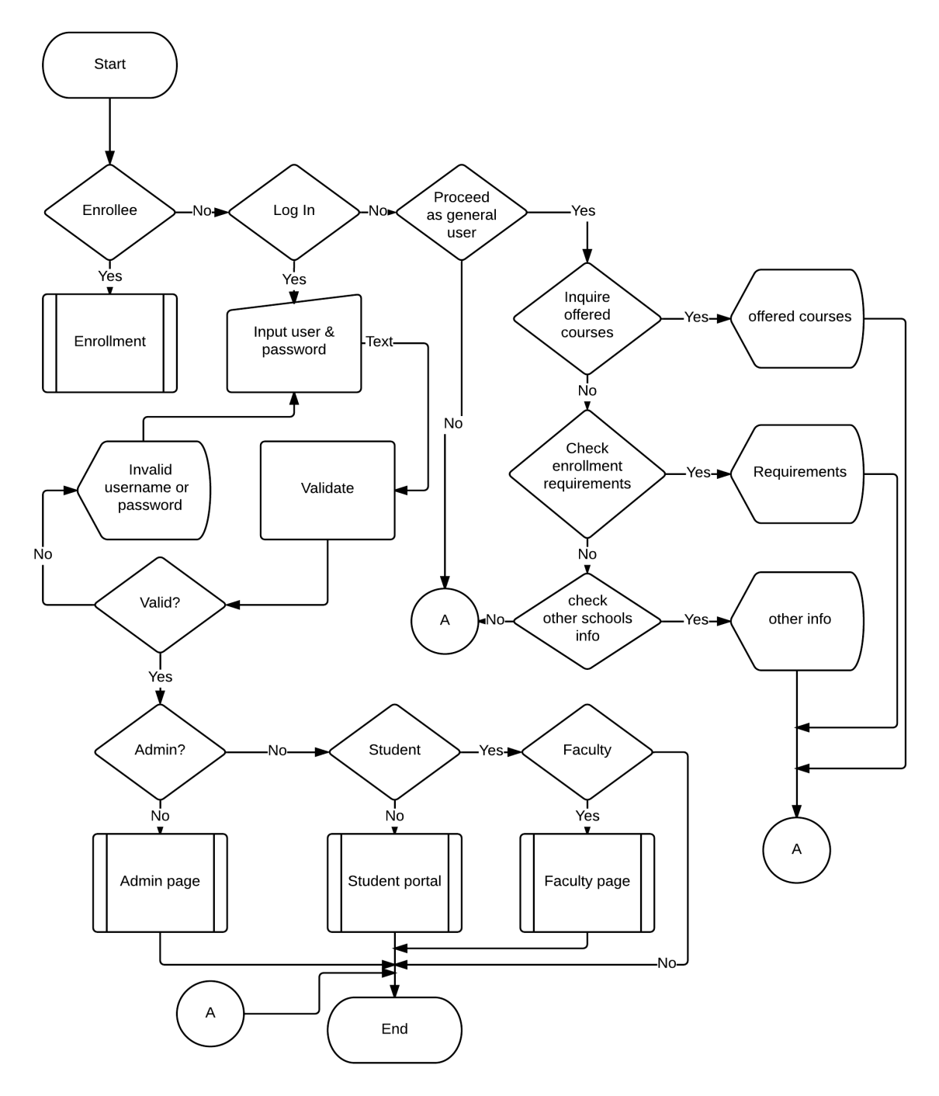
Main Page Flowchart

Slide 50
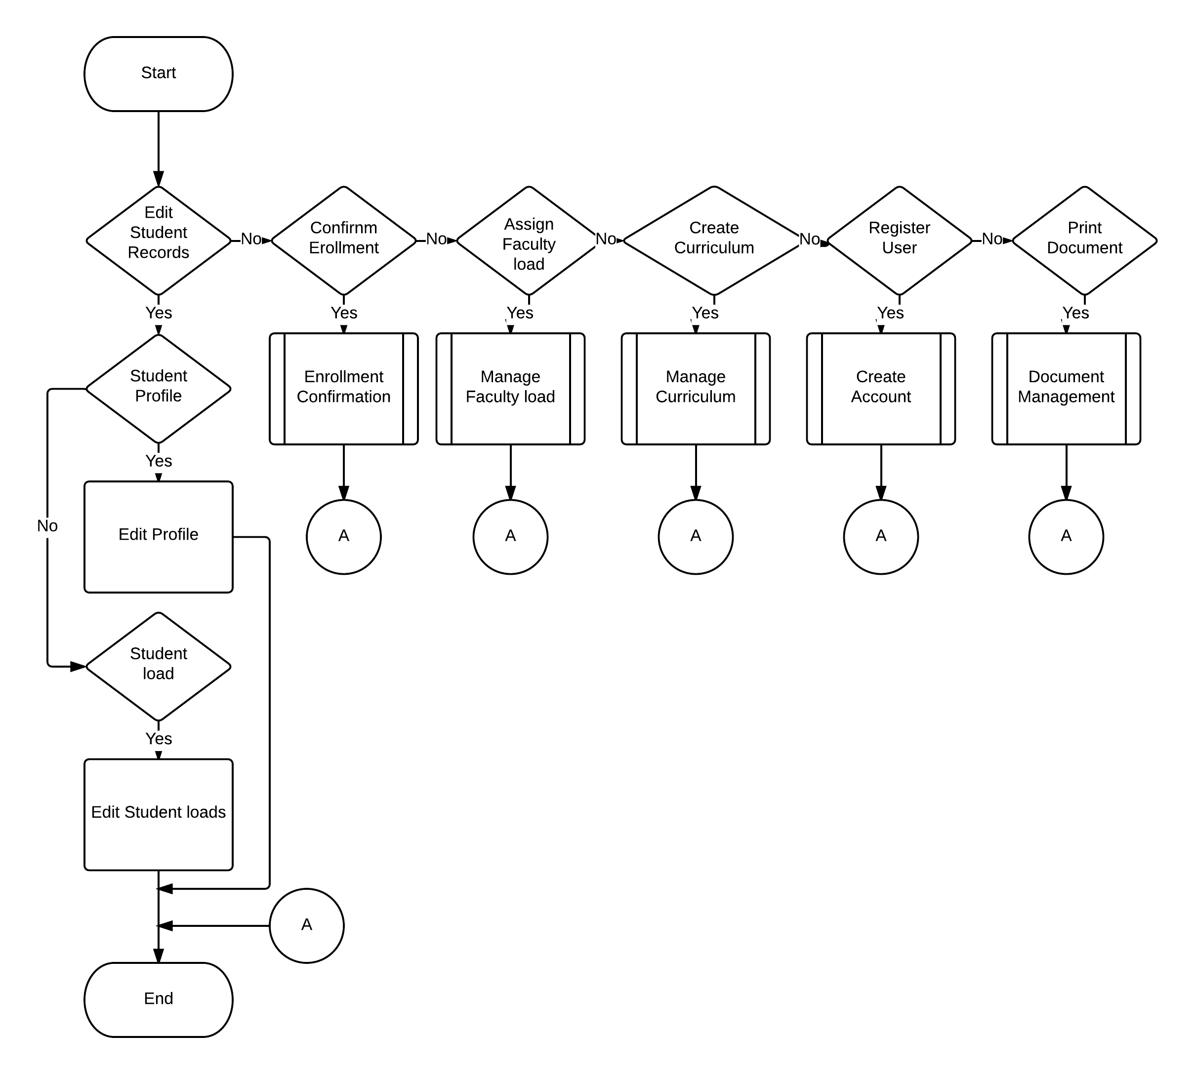
Admin Flowchart

Slide 51
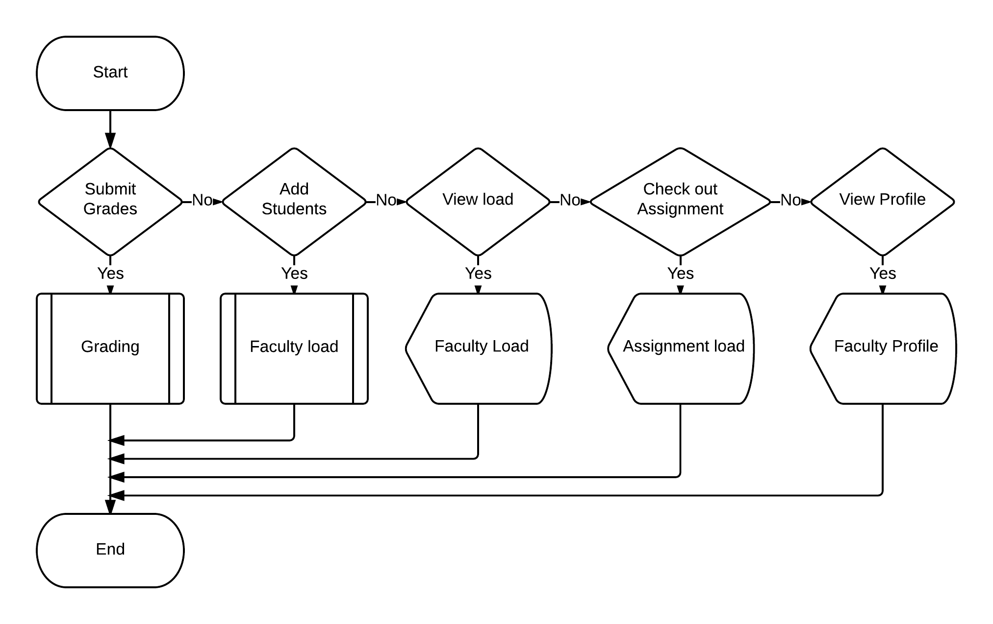
Faculty Page Flowchart

Slide 52
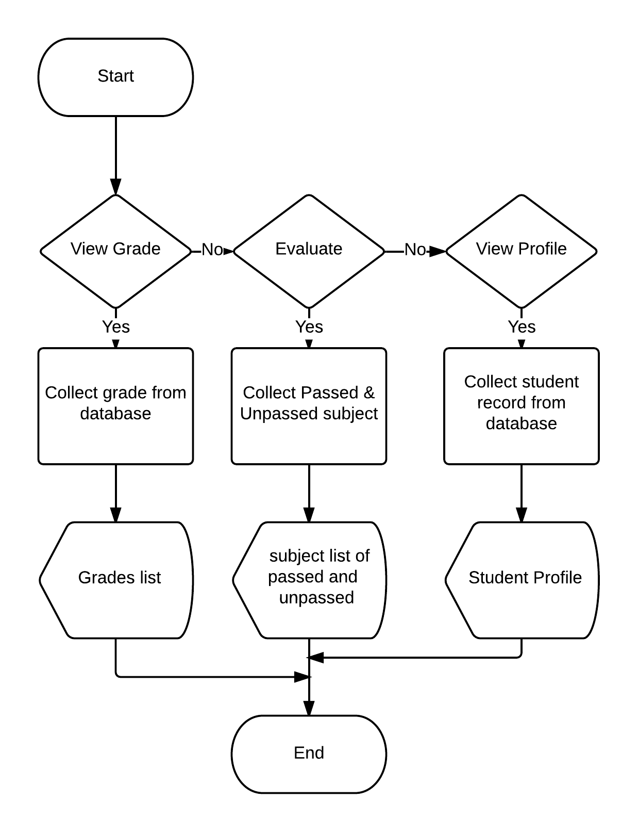
Student Page Flowchart

Slide 53
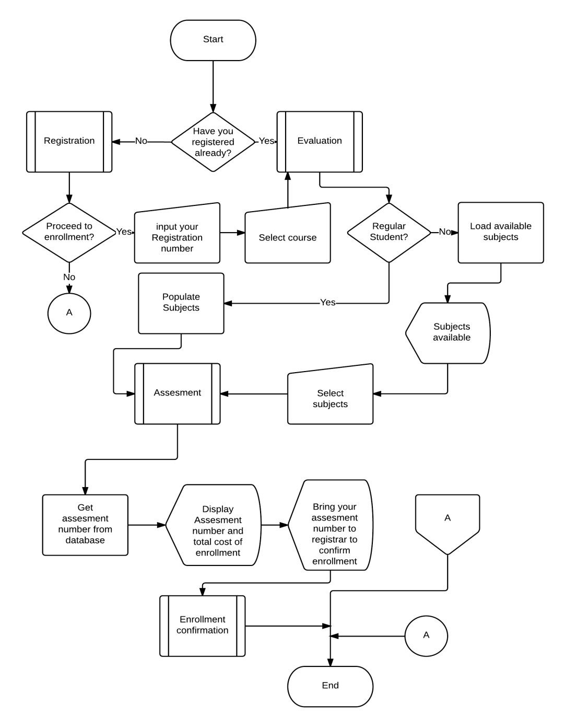
Enrollment flowchart

Slide 54
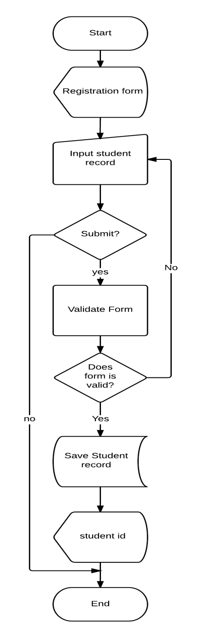
Registration Flowchart

Slide 55
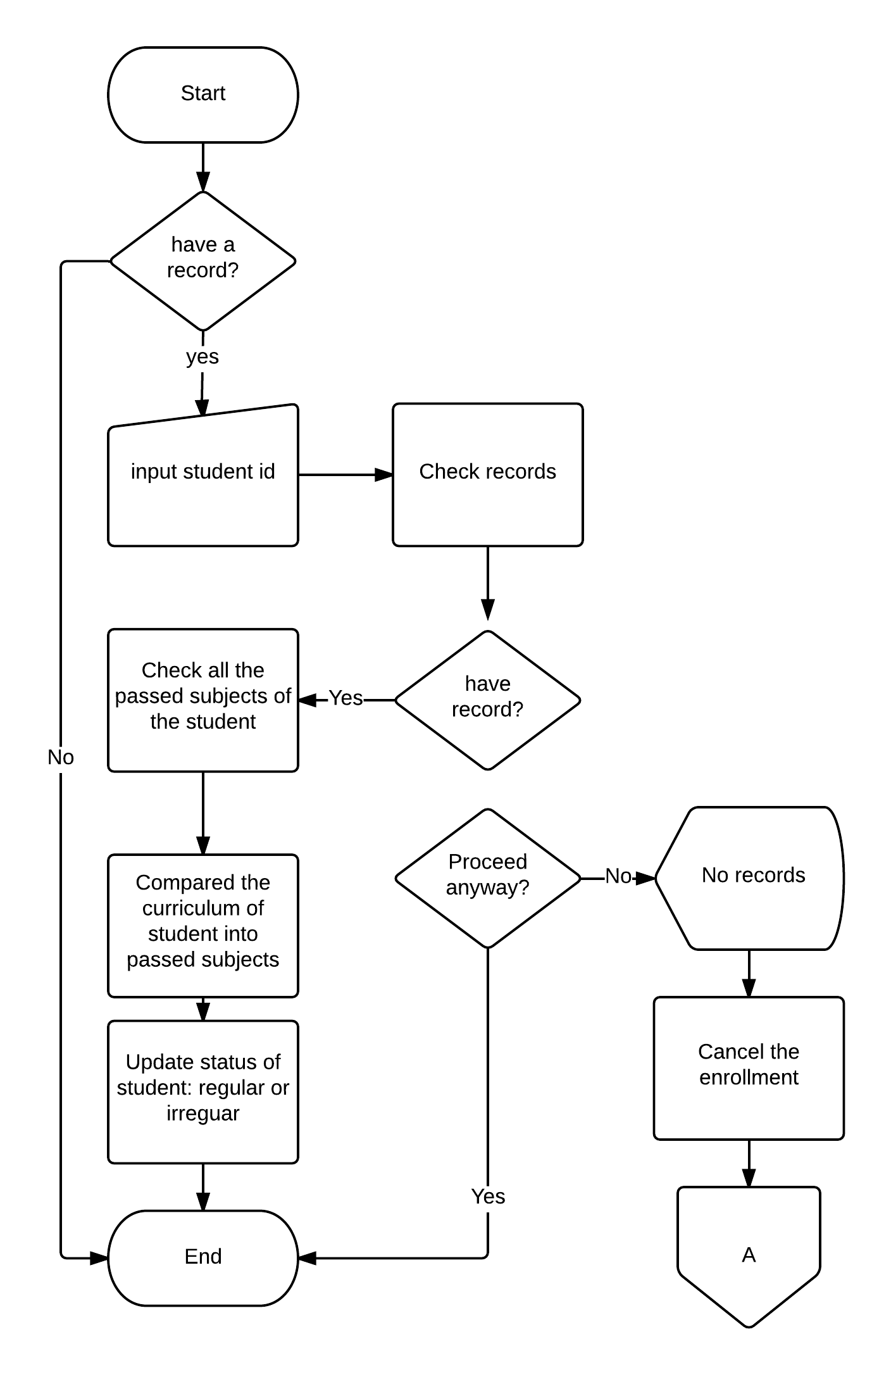
Evaluation flowchart

Slide 56
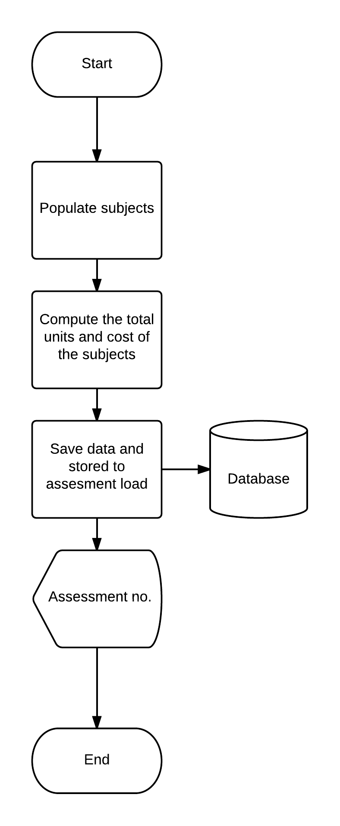
Assessment flowchart

Slide 57
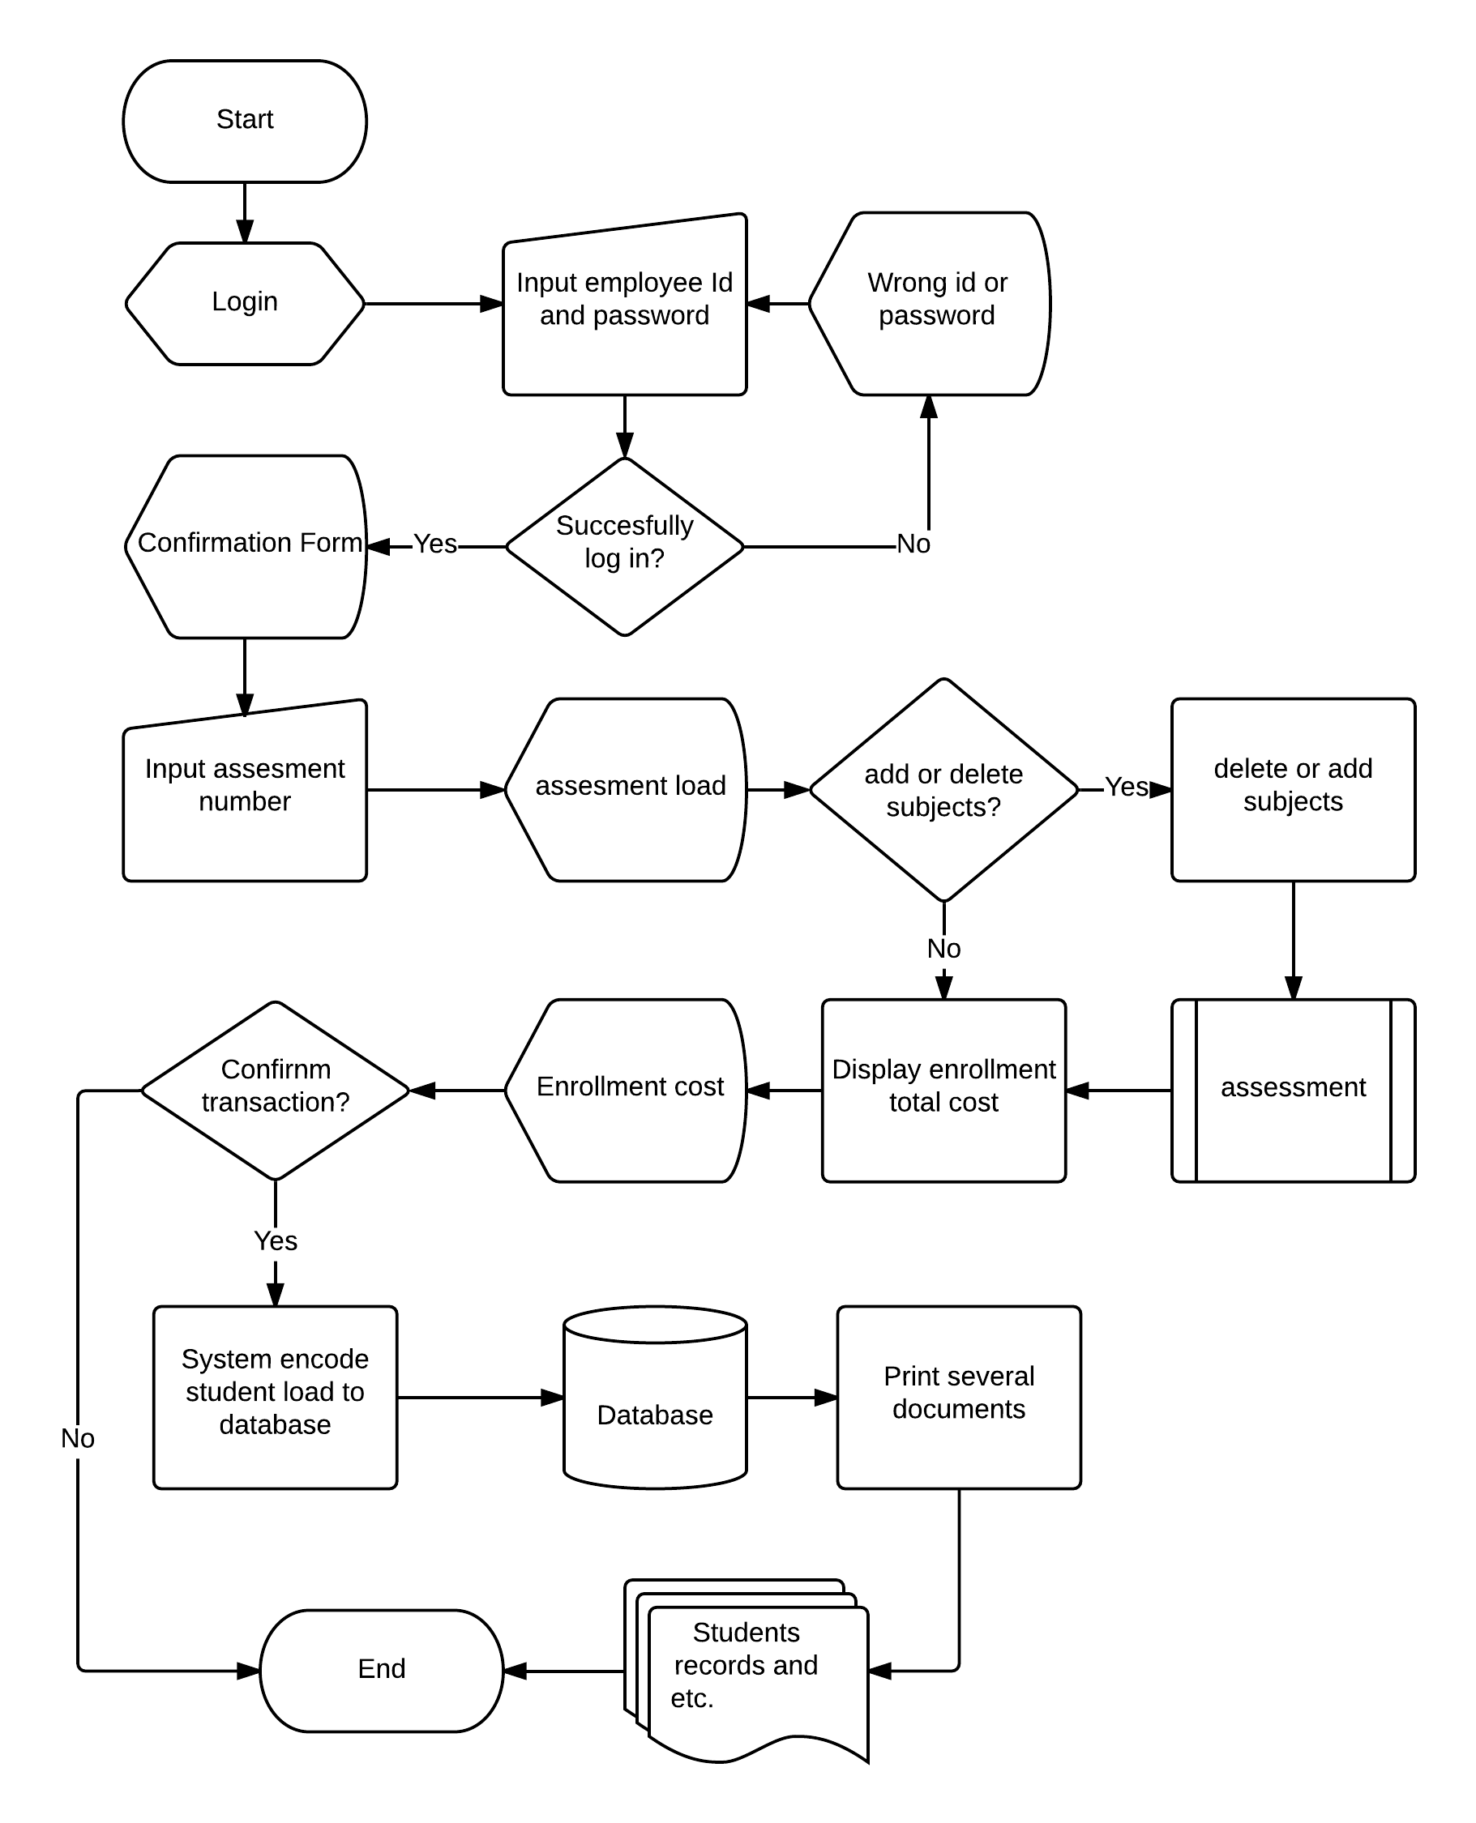
Enrollment confirmation flowchart

Slide 58
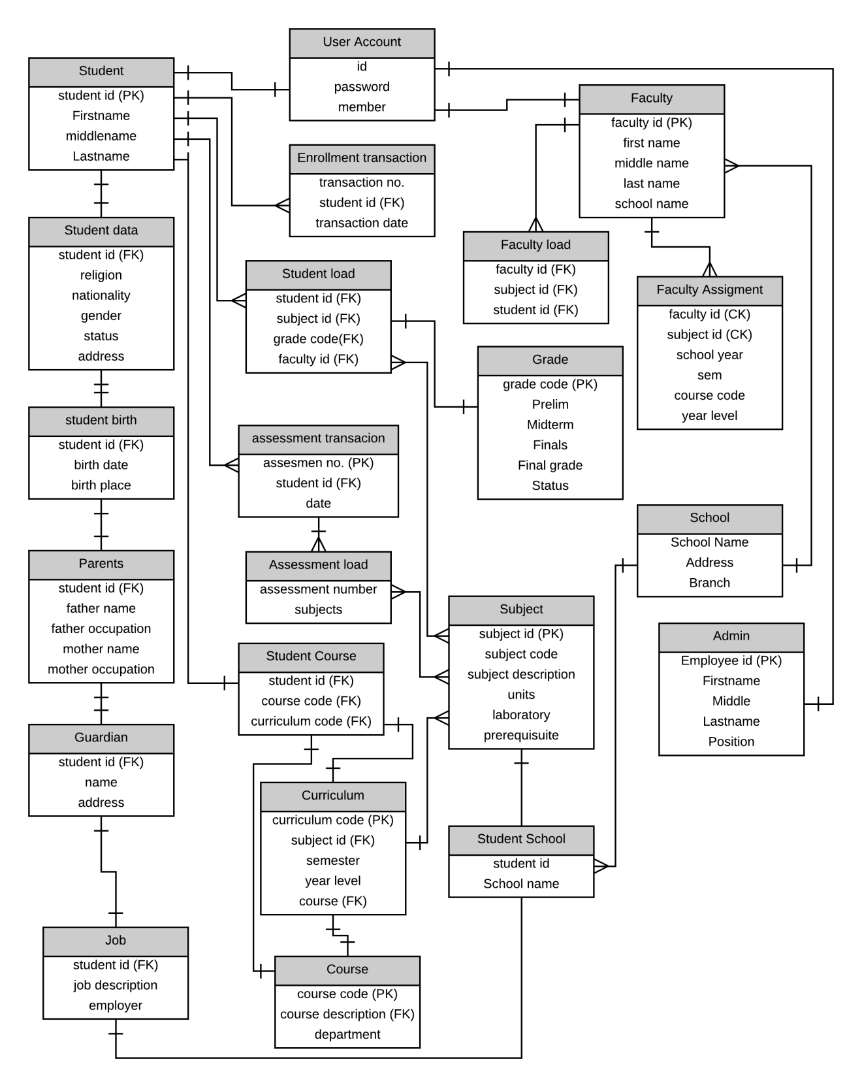
Entity Relationship Diagram

